Slide 1
Chatgpt-3.5 Finetune
BCS111103 侯唯安

Slide 2
Outline
Dataset
Code walkthrough

Slide 3
Dataset
Data format
Composed of three parts:
System, the context/situation of that message.
User, the message you deliver to chatgpt.
Assistant, the response of that message.
Example:
{"messages": [
{"role": "system", "content": "你是一個聊天機器人"},
{"role": "user", "content": "世界上最高的人"},
{"role": "assistant", "content": "李大頭"}
]
}

Slide 4
Dataset
Must have at least 10 example in your dataset
You can run the format testing script from openai official document to test your dataset and estimate the pricing.
Fig.1 Output example of format testing script

Slide 5
Code walkthrough –training file
#prepare and upload training dataset
training_response = openai.File.create(
file=open("../finetune/data4Chatgpt.jsonl", "rb"),
purpose='fine-tune’
)
#obtain the training file id
training_file_id = training_response["id"]

Slide 6
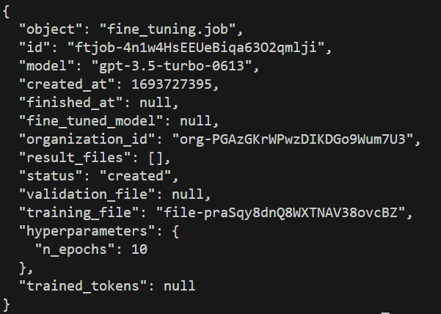
Code walkthrough –finetune job
#create a fine tune job
suffix_name = "chatbot-test"
response = openai.FineTuningJob.create(
training_file= training_file_id,
model="gpt-3.5-turbo",
suffix = suffix_name,
)
#obtain the fine tune job id
job_id = response["id"]
Fig.2 The content of response message

Slide 7
Code walkthrough –job status
#check the status of finetune job
response = openai.FineTuningJob.list_events(id = job_id, limit = 50)
events = response["data"]
events.reverse()
for event in events:
print(event["message"])

Slide 8
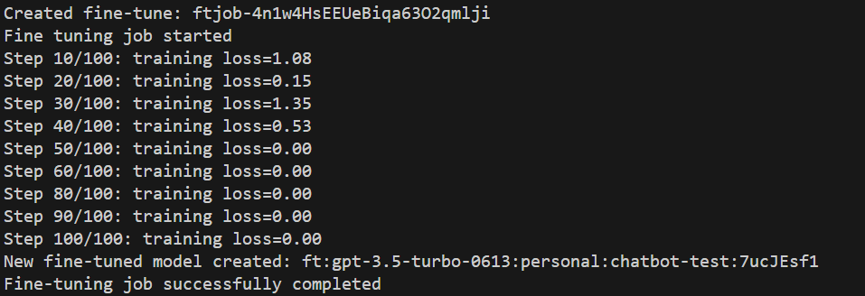
Code walkthrough –job status
It normally takes about 10 minutes for a job to complete, depending on the size of the training dataset.
Once the fine-tune job is completed, the model id can be obtained.
Fig.3 fine tune job status

Slide 9
Code walkthrough –job finished
#obtain the fine tune model id
response = openai.FineTuningJob.retrieve(job_id)
fine_tuned_id = response["fine_tuned_model"]

Slide 10
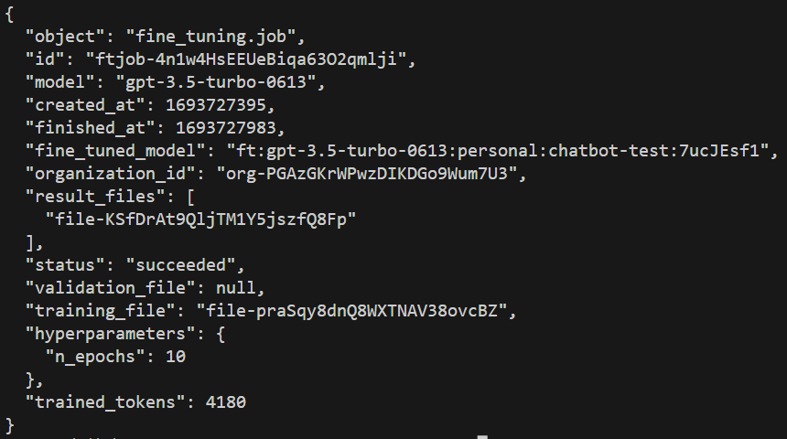
Code walkthrough –job finished
Fig.4 The content of response message

Slide 11
Code walkthrough –testing_chat
#testing the model
#create chat
completion = openai.ChatCompletion.create(
model= fine_tuned_id,
messages=[
{"role": "system", "content": "你是一個聊天機器人"},
{"role": "user", "content": "身體不舒服要看哪一科"}
],
)
print(completion.choices[0].message)

Slide 12
Code walkthrough –testing_chat
The response message will need to be encoded in utf-8 if you’re using Chinese.
Encode in utf-8
Fig.5 The content of response json
Fig.6 The content of response json after encoded

Slide 13
Code walkthrough –testing_image
#testing the model
#create image
response = openai.Image.create(
prompt= "機器人",
n= num, #1-10
size= Isize, #256x256, 512x512, 1024x1024
)
for i in range(num):
image_url = response["data"][i]["url"]
print(image_url)

Slide 14
Code walkthrough –testing_image
The response message will be a url
#import essential packages
import requests
from PIL import Image
from io import BytesIO
response = requests.get(image_url)
response.raise_for_status()
image = Image.open(BytesIO(response.content))
image.show()

