Slide 1
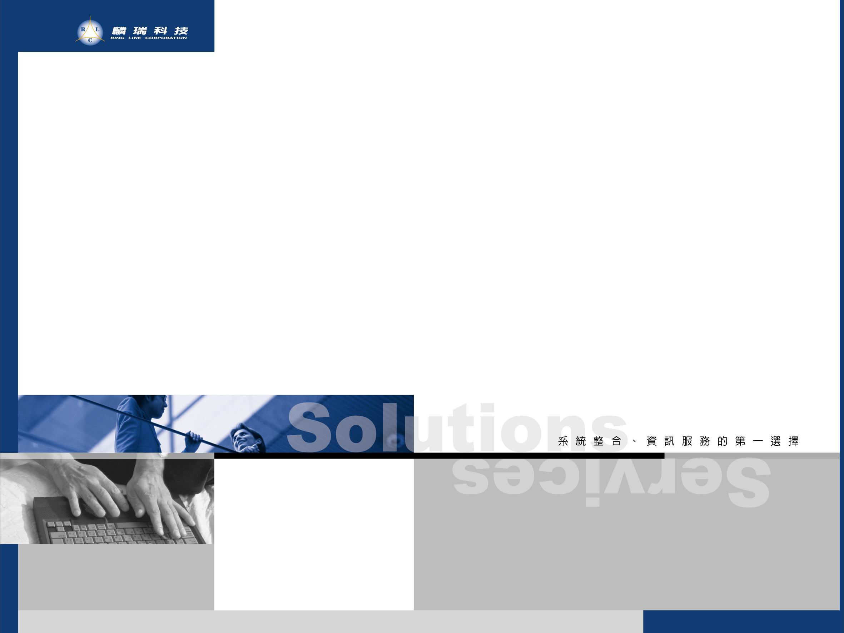
虛擬化主機概念與備援介紹

Slide 2
簡報大綱
建議架構
未來規劃建議
Acronis Backup&Recovery介紹
VMware vSphere介紹
NetApp介紹

Slide 3
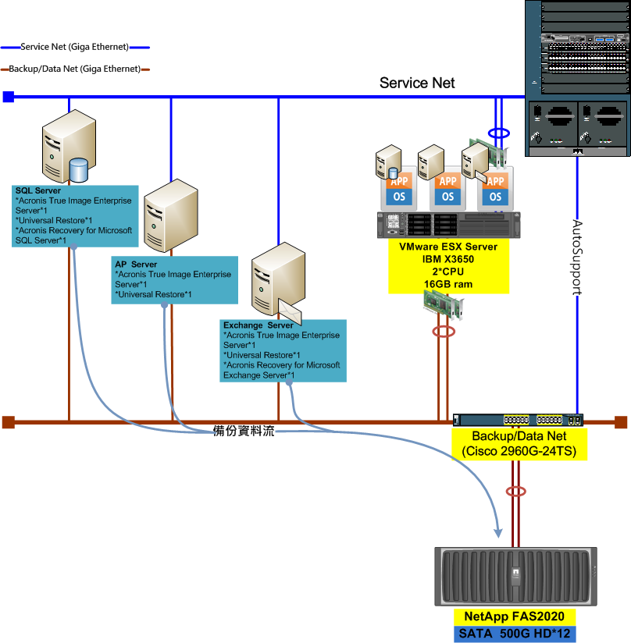
建議架構圖

Slide 4
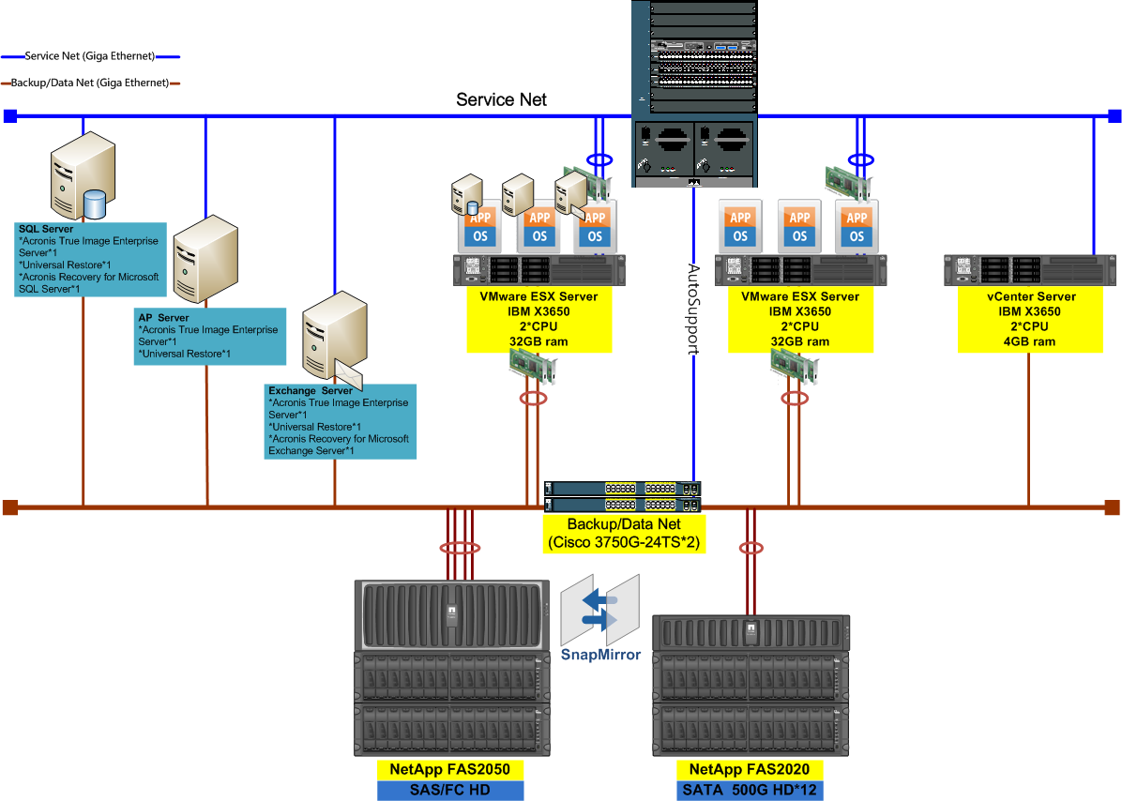
未來建議架構圖

Slide 5
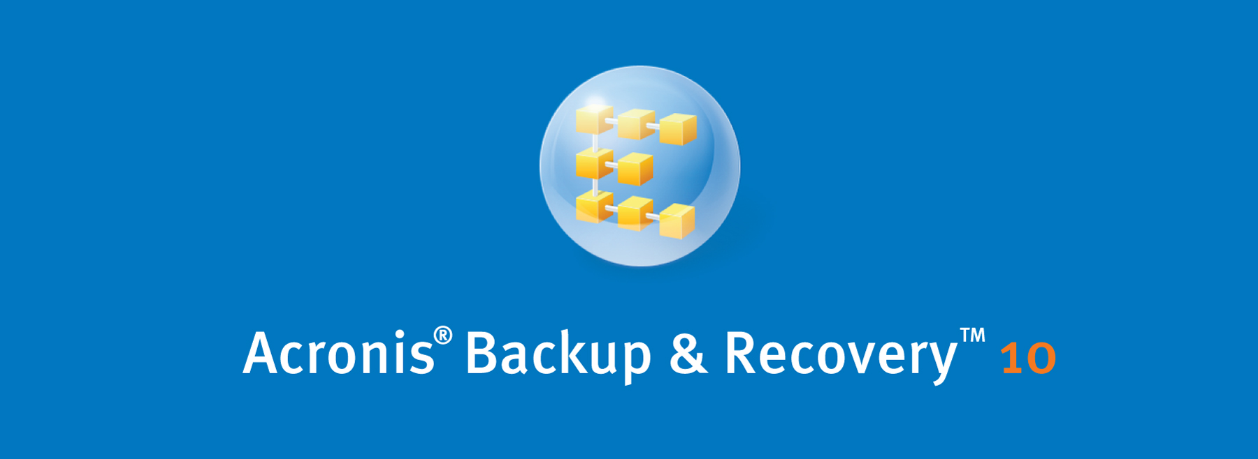

重複數據刪除和備份
及災難復原整合方案

Slide 6
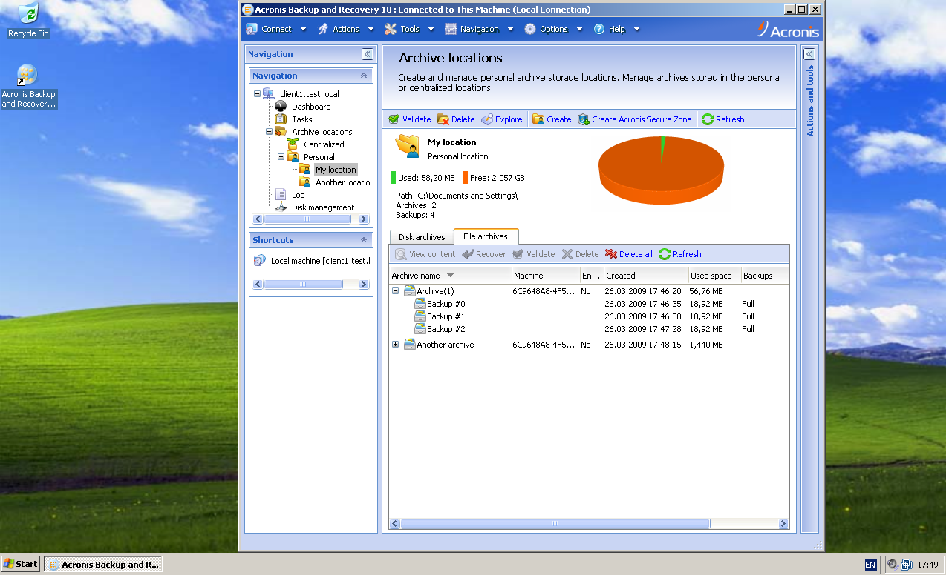
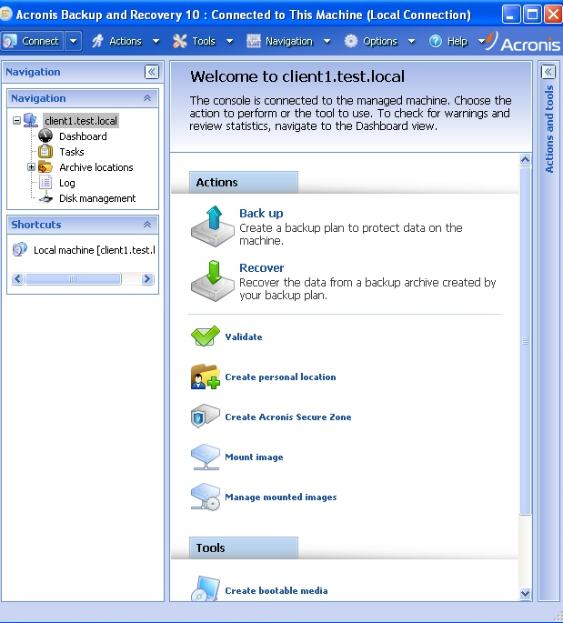
直覺易用的介面
GUI 經過改造，以切合企業需要。使用左側的樹狀目錄，瀏覽更方便。
以表單取代精靈，簡化工作設定
單一畫面包含更多資訊，可減少切換內容的次數回應時間改善

Slide 7
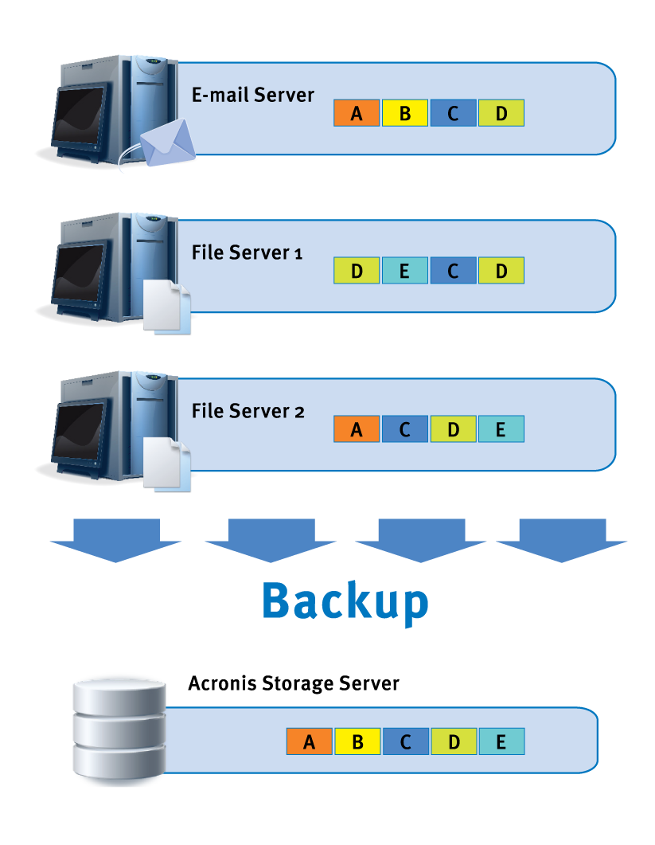
重複資料刪除
來源端或目標端檔案與資料區塊層級的重複資料刪除，可消除多餘的資料
Deduplication
If a copy of a file/ block is already in a location, only the link is saved instead of second copy
For deduplication at source, second copy is not transferred over network
Applies to Full, Incremental & Differential Backups
File and disk backup support
Can be turned on/off for managed centralized vault
以附加元件的形式提供，僅限進階版
(即 Advanced Server、Advanced Workstation、SBS Edition 及 Virtual Edition)。

Slide 8
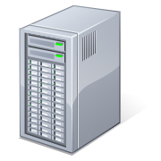
創新的 VM 備份方式Virtual Edition
虛擬伺服器
Backup from a host
無限制的虛擬化移轉授權
不必在每一部虛擬機器上安裝個別代理程式即可備份整部虛擬機器(ESX & Hyper-V )
Works the same way as restore, including custom disk mapping
Convert ABR10 backup to a VM: now creates entire virtual machine or VM appliance rather than single VHD file
支援 VMwareand VMware ESX、Microsoft Hyper-V、Citrix XenServer 以及 Parallels 等虛擬平台
Hypervisor
VM 1
ABR10
VM 代理程式
VM 2
VM n
BACKUP
Acronis 儲存節點
VM 1
VM 2
VM n
Virtual Edition 包含從主機備份的功能
Notes:
這一版產品整合 VMware 與 MS Hyper-V API，不必在每一部 VM 中安裝用戶端即可備份 VM。如此可節省資源，簡化 VM 備份作業。
僅 Virtual Edition 提供此功能。

Slide 9
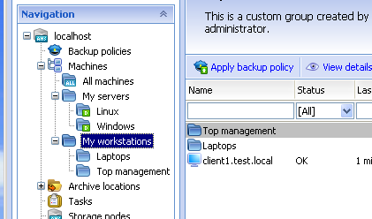
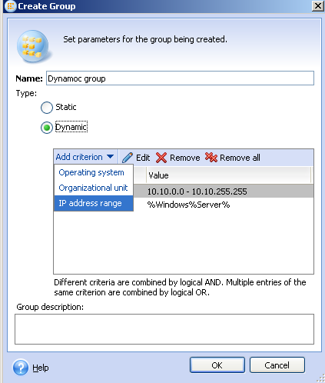
電腦分組
Static groups
To static groups machines are added manually
Dynamic groups
To dynamic group machines are put automatically based on criteria
IP range
Operating system
Architecture (x86 or x64)
Flexibility
Groups can be nested; single machine can belong to multiple groups
Groups are perfect targets for policies
Simplifies administration as only machines of interest can be displayed

Slide 10
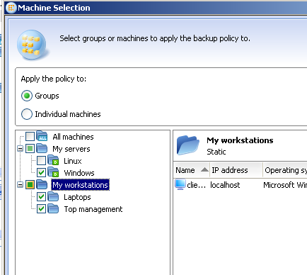
原則式管理
Create centralized policy
2
3
Corresponding actions will be enforced on machines
1
Select a group of machines or other managed entities
Apply policy to a group
4
Notes
Policy specifies reusable configuration for backup, validation, consolidation and retention
Machines can be added to group manually or automatically by rule
If group content is changed, actions will be re-enforced accordingly

Slide 11
儲藏庫
利用備份群組存放對應的存檔
Personal Vaults
Centralized Vaults
Administrator can enforce vaults to appear on each managed machine
Vaults can be registered in GUI locally on specific machine for easy access
Acronis Storage Node vaults (AKA managed vaults) are always centralized vaults
Vaults
Now backups are grouped by archives they belong to and are stored in vaults
Vaults can be browsed from ABR10 GUI – no need to use OS file manager any longer
Notes:
不必用到硬碟櫃！

Slide 12
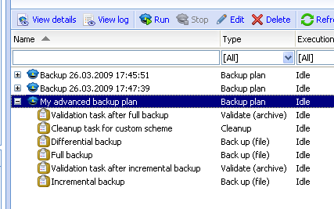
精密的工作管理
Backup Plans
Forever incremental
Usually company’s backup strategy implies multiple activities
Full backup
Incremental and differential backup
Regular validation
Delete retired backups
Achieve by backup scheme called “Simple”
A set of related activities (tasks) is created, shown and managed as single Backup Plan
Create full backup once, and only incremental afterwards
With consolidation involved, old backups are deleted on a server side

Slide 13
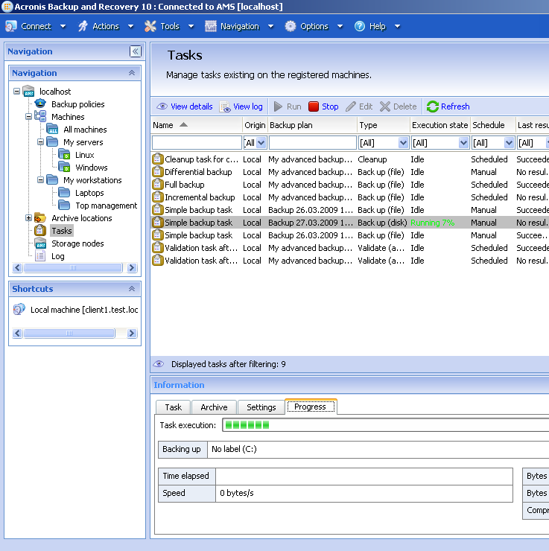
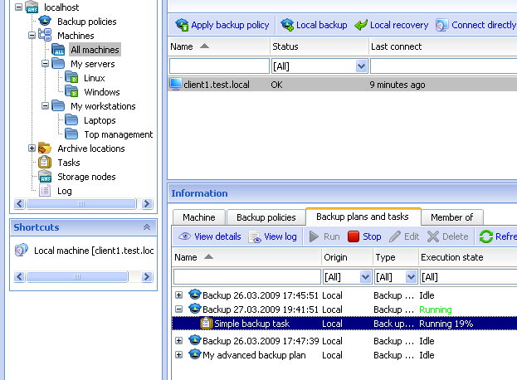
集中監看進度
Progress monitoring
Progresses and states of all tasks can be seen centrally in AMS UI
All actions like “cancel” can be performed right from that screen too
Cumulative statues
Machines and policies have cumulative statuses that shows if something goes wrong with that machine or policy

Slide 14
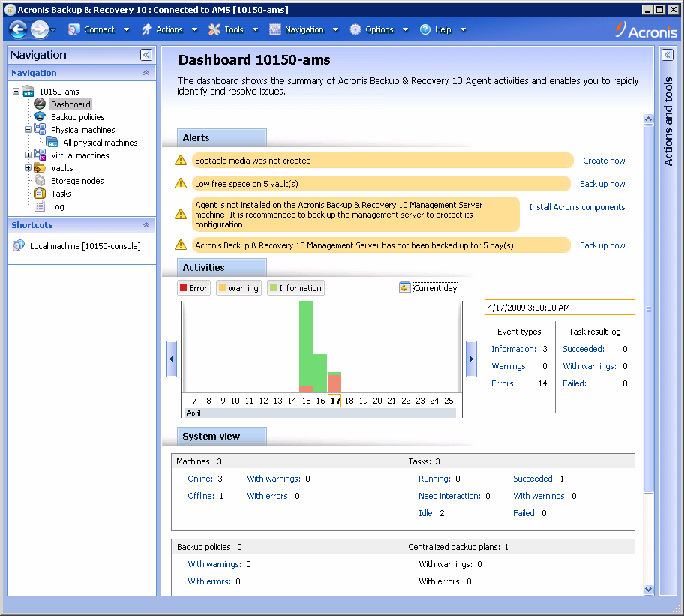
儀表板
監視效能及追蹤關鍵指標，以迅速識別並解決問題
Local dashboard
Centralized dashboard
Shows overview of all Acronis Backup & Recovery operations on a machine
Alerts section warns user if something is going wrong or user action is required
Cumulative information about all machines and storage across all managed machines and storage nodes

Slide 15
VMware vSphere™ 4.0
The best platform for building cloud infrastructures
Notes:
. VMware vSphere™ 4 is the industry’s first cloud operating system, transforming datacenters into dramatically simplified cloud infrastructure and enabling the next generation of flexible, reliable IT services.

Slide 16


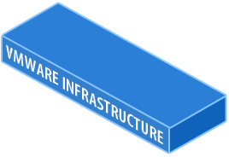
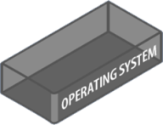
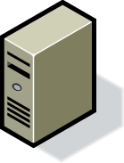
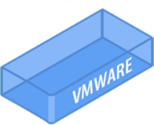
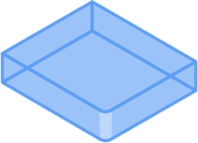
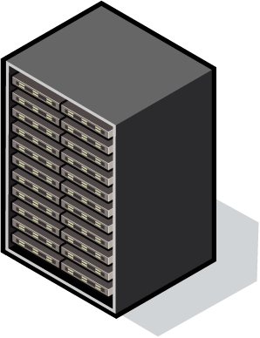
Virtualization: Fundamentally Better
Run several operating systems on a single machine.
Create shared pools of resources to optimize your infrastructure.
Notes:
16

Slide 17



Cloud OS - The Underpinning For Cloud Infrastructures
Private Cloud
App
Loads
App
Loads
App
Loads
App
Loads
App
Loads
Management
Management
Federation & Choice
Cloud OS
Cloud OS
Standards
Internal
Clouds
External
Clouds
Notes:
Additionally , The Cloud OS provides a common platform for datacenters and service providers, linked through federation and standards based interaction allowing the creation of private clouds leveraging common management services
This allows datacenters to retain the choice of how they provide computing…without getting locked out of external clouds at a later date

Slide 18
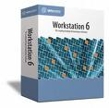
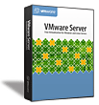
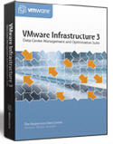
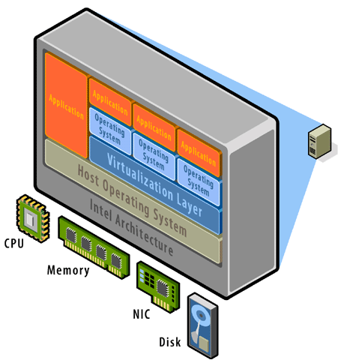
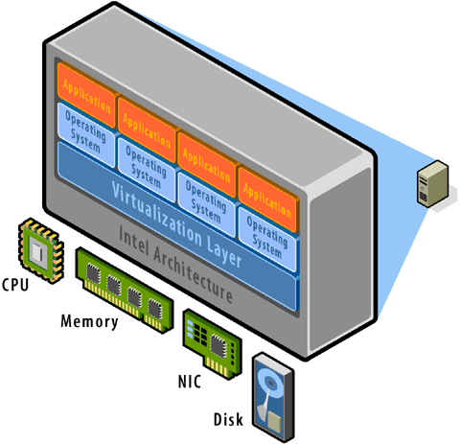
VMware 虛擬平台
寄居架構 (Hosted Architecture)
高級架構 (“Bare Metal” Architecture)
彈性佳
效能40-60%
ESX Server
企業級應用功能
高效能
80-90%
前身GSX Server
Notes:
找找看有啥不同
規格上不同

Slide 19
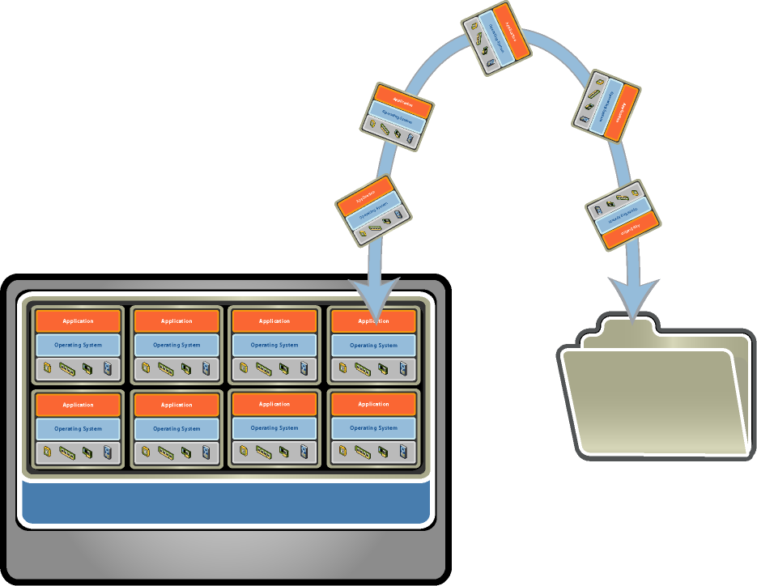
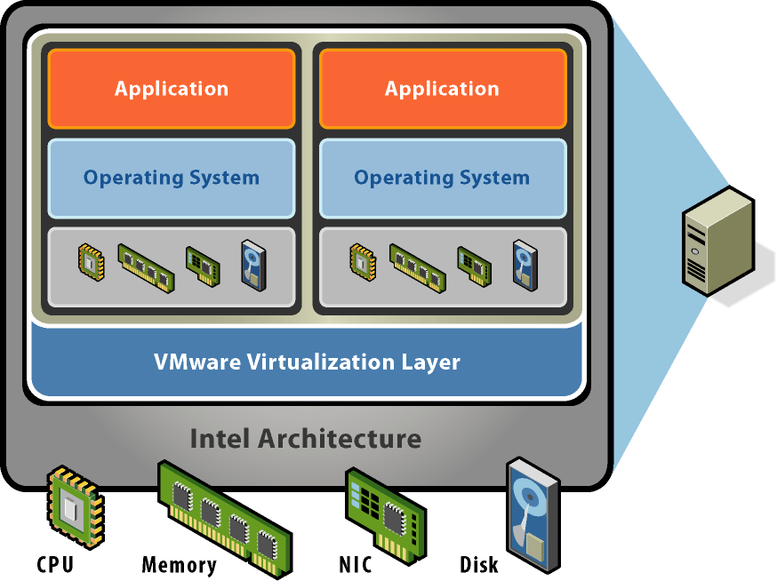
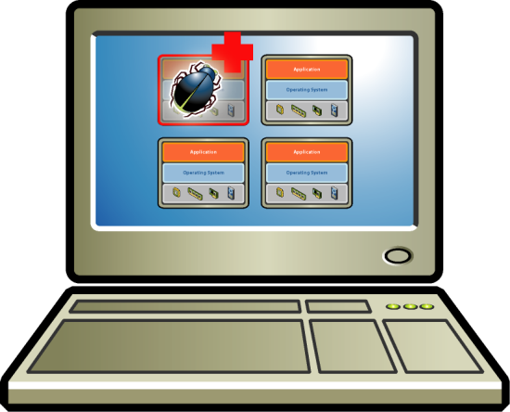
VMware 虛擬科技：三大特性
相容性
虛擬機器可以任意的在不同硬體平台上運作
虛擬機器使用ㄧ制的虛擬硬體規格
沒有硬體轉換時的困擾
分隔性
每個虛擬機器的運作是獨立進行, 不受其它虛擬機器影響
能夠動態調配虛擬機器的中央處理器 (CPU), 記憶體 (Memory), 貯存硬盤 (Disk), 及 網絡(Network) 等等資源
確保服務質素承諾 (SLA)
封裝性
每一虛擬機器的主機跟運作狀態都是以一個檔案代表, 提高可攜性
能將虛擬機器的運作狀態貯存
,透過→快照,或冷熱備份機制
Notes:
[Click ONCE to show the bullets for each graphic]
We typically break describe three key properties of virtual machines that are responsible for their powerful benefits. Let’s examine each one of those properties…
The first key property is partitioning. Virtual machines allow a single computer to be divided into separated partitions that can each run an operating system and application stack concurrently. In fact, those virtual machines can be running completely different operating systems and software because they each have their own virtual storage locations, memory spaces and networking interfaces. A component of the VMware virtualization layer called the virtual machine monitor manages the concurrent execution of each virtual machine on the host system hardware. Typically we’d actually see a ratio of about 4 to 8 running virtual machines per physical CPU. The networking and storage features of virtual machines let you use them just as you would real machines in networked configurations or joined together in clusters for high-availability.
2. Our second critical feature is isolation which is critical for safe and reliable server consolidation.
VMware Virtual machine monitors use the hardware protection features of the CPU to isolate the virtual machines from each other and the monitor. By basing our isolation on the hardware protection we get very strong isolation. In other words, there is unlikely to be a hole. Each virtual machine is isolated from the host and other VMs, in the sense that it doesn’t share a kernel or processes.
In a real environment, what this means is that applications in one virtual machine can encounter viruses or blue screen their operating system, and there is no effect on any other virtual machine. In fact, we had the U.S. National Security Agency try to hack from one virtual machine to another for over a year and they couldn’t find any weaknesses to exploit. That proven isolation strength has led the NSA to approve VMware technology for running insecure off-the-shelf software on their secure machines.
Resource controls & isolation features give application owners full protection from the stability and performance problems of other applications. A virtual machine with an application leaking memory or a runaway process consuming CPU can only use as much of the host resources as you’ve allocated to that virtual machine. The neighboring virtual machines will retain their allocations of CPU, memory, disk I/O and network I/O.
Isolation and resource controls removes end user objections to server consolidation because you can guarantee service levels and security.
3. Our third primary feature of virtual machines is encapsulation. The complete state of a virtual machine – memory, disk storage, I/O device and CPU state, and virtual hardware configuration – is stored in a small set of files. These files are hardware independent so you can move a virtual machine from one x86 system – say a Dell server– to another – say an IBM server – and that virtual machine will run with no changes necessary as long as the VMware virtualization layer is present. An encapsulated virtual machine is at a minimum just the virtual machine configuration file (a small text file defining the virtual machine’s properties) and the virtual disk file that contains its installed operating system. A snapshot of a running virtual machine would add files encapsulating the memory and processor state of the virtual machine so that a point-in-time image of a running virtual machine can be saved and reverted to at any time. Encapsulation means that your ability to copy, save, and move virtual machines wherever and whenever you need them is as simple as copying a directory of files.

Slide 20
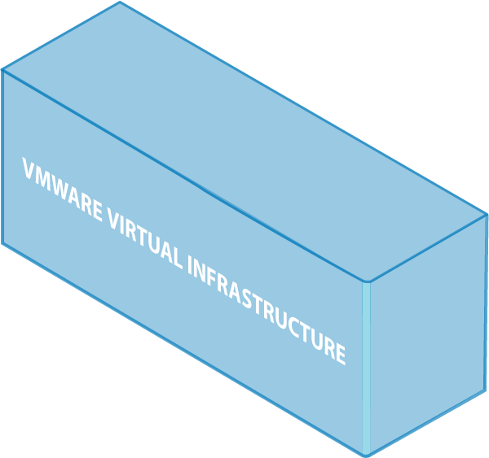


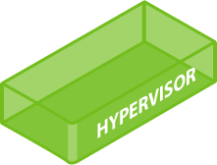

豈只是一台小小的虛擬伺服器？
使用虛擬架構轉移或是
部署環境，輕而易舉
完全脫離硬體限制與包袱

Slide 21

















Proven Solution, Unrivaled Customer Success
Most Proven,
Trusted Platform
140,000+ VMware customers
  100% of Fortune 100
  98% of Fortune 1000
94% use VMware in production
70% VMware as the default application platform
65% use live migration
in production
全球所有虛擬化應用程式中，
有 89% 是在 VMware 上運行。
Gartner，2008 年 12 月
The World’s Most Successful Companies Run VMware
(hundreds of customer stories on www.vmware.com)

Slide 22
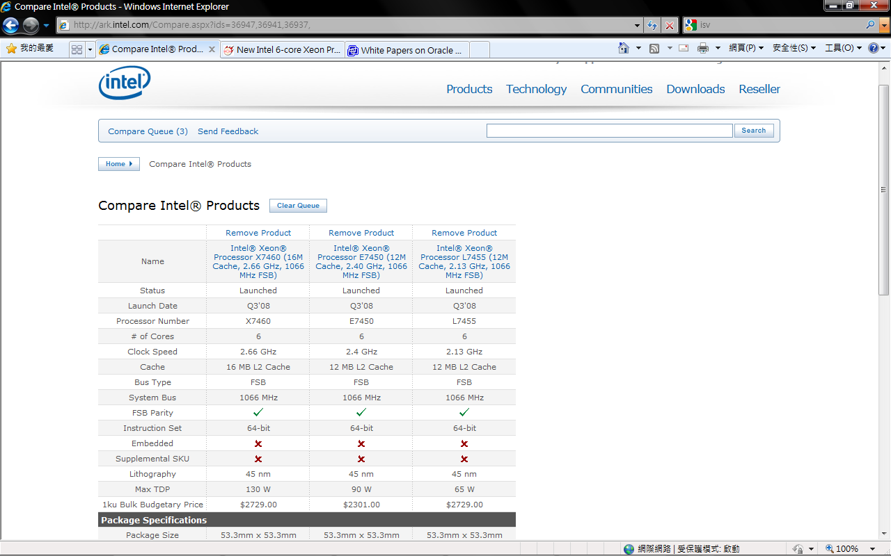
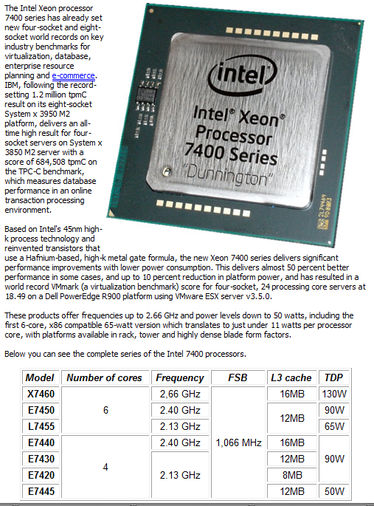

Slide 23
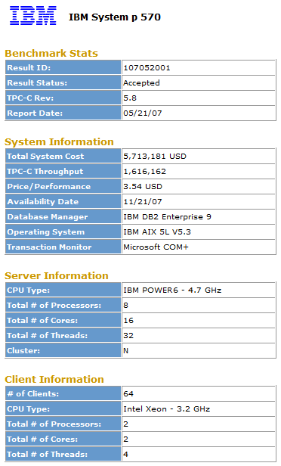
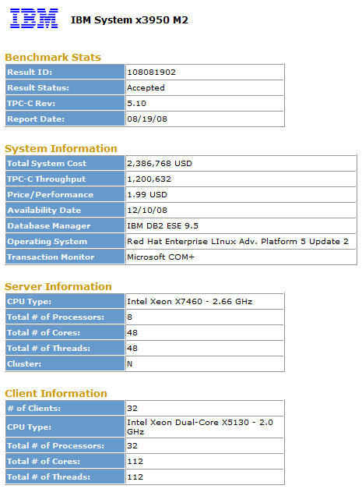

Slide 24
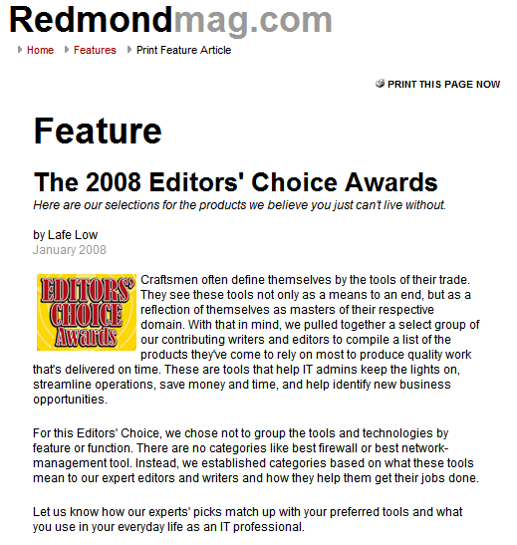
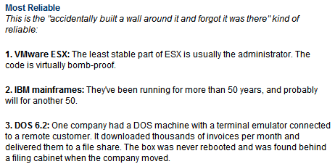
VMware ESX: Even More Reliable than a Mainframe!
Notes:
[begin]
To further establish the reliability of VMware solutions and to support our own messaging, we can also point to external validation. Providing customers with examples of industry analysts and press confirming VMware’s product superiority and stating that VMware solutions are robust and reliable can be very effective, as these statements are viewed as less biased than if the same message had come from the vendor itself.
There are numerous examples we can use to support VMware messages, however the article featured here provides a great example of what our customers already know – from a very credible source! In its 2008 editors’ choice awards, Redmond Magazine, which bills itself as “the independent voice of the Microsoft IT community”, named VMware ESX the “most reliable” IT product, stating that the “least stable part of ESX is usually the administrator”. Note also that this category was not limited to software – VMware ESX even beat out the IBM Mainframe, the industry benchmark for technology robustness and reliability.

Slide 25
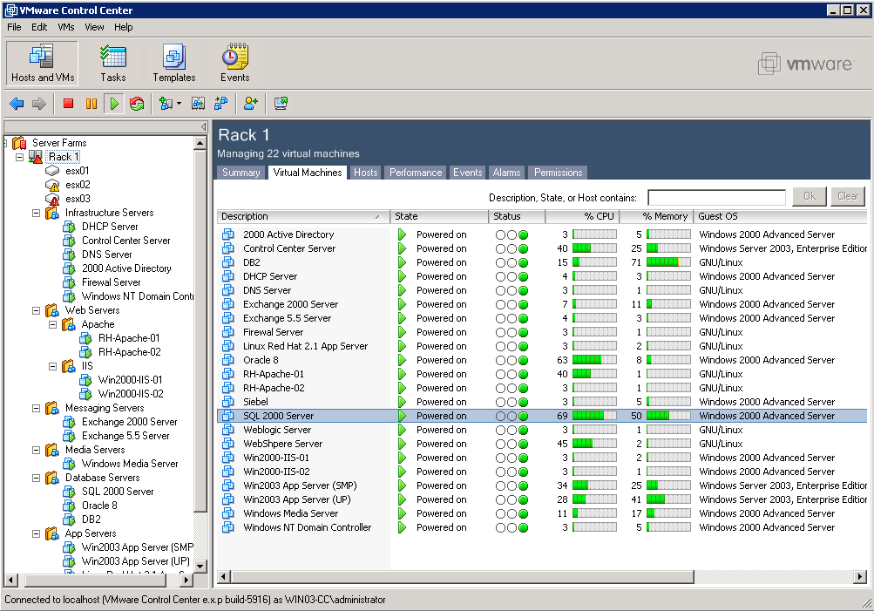
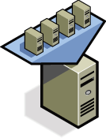
vCenter Sever 虛擬伺服器集中管理中心
  集中管理數以百計的伺服器及 VM
  (VirtualCenter scales to 200 hosts and 2000 VMs)
  使用標準樣板(Template) 來部署新服務器
  彈性調配服務器上虛擬機器的負載量
  對虛擬機提供階層角色的管控環境
  支援虛擬架構之特殊功能：VMotion,VMHA,VMDRS…
Notes:
What does VirtualCenter really do? It creates virtual infrastructure and manages it. It solves those key problems of:
How to manage the large number of machines, deliver the large variety of services.
How to get the most efficiency out of the hardware we have today.
How to Ensure consistent, secure deployments time and time again
BECAUSE IT:
MANAGES A LOT OF SERVERS EASILY. EFFICIENCY
SAVES TIME WITH INSTANT PROVISIONING. FLEXIBILITY
STANDARD TEMPLATES CREATE CONSISTENT DEPLOYMENTS AUTOMATICALLY
ZERO-DOWNTIME MAINTENANCE. FLEXIBILITY
WORKLOAD MANAGEMENT ACROSS DATACENTER. COST
SECURE AND ROBUST. INTEGRATED WITH WHAT YOU HAVE TODAY.

Slide 26
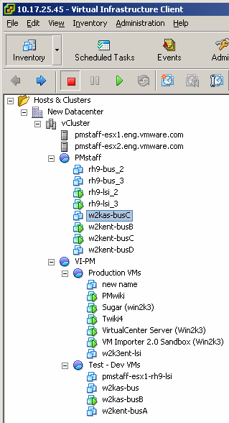
管理介面
資料中心
ESX Server主機與虛擬機之即時效能圖
伺服器叢集
虛擬機器
ESX Server主機
資源池

Slide 27
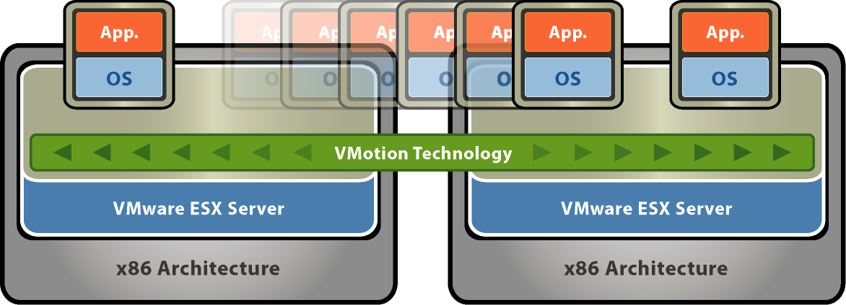

VMotion ：虛擬機器乾坤大挪移
VMotion 技術讓您搬移正在運行中的虛擬機器到負載較輕的硬體上, 且整個轉移過程更不需中斷服務
Live migration of virtual machines
Zero downtime
SAN
ISCSI
NAS
Shared Storage
Notes:
But really the core is VMotion technology. Lets you Adjust resources to demand. If you suddenly were flooded by demand, you can move servers to handle it.
VMotion technology lets you move live, running virtual machines from one host to another while maintaining continuous service availability. VMotion allows fast reconfiguration and optimization of resources across the virtual infrastructure because you can make changes on the fly, without impacting users.
VMotion enables you to move the machine without user service interruption. Applications don’t have to be taken off line. VMotion is a huge advantage when doing hardware maintenance or when re-balancing workloads across servers.
It also gives you optimal utilization etc.
Let’s consider each of these

Slide 28
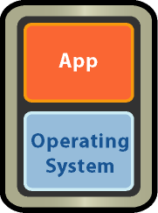


VMware DRS – 自動化資源分配
DRS
動態平衡資源負載
最佳化營運品質
Shared Storage

Slide 29

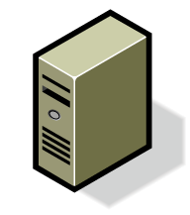
使用VMware技術達成不停機維護
使用Vmotion撤離主機
不停機移動線上服務到其他實體伺服器
  使用DRS技術維護伺服器間的資源負載平衡
  自動移動虛擬機器到其他實體伺服器上
  當維護動作結束後自動化重新計算負載資源
VMotion
VMotion
2.DRS遷移運作中的虛擬機器到其他實體伺服器
1.進入維護模式
3.伺服器停機進行維護動作
4.重新啟動伺服器; DRS 自動重新均衡workloads

Slide 30
防止由於資源不足造成的意外
實體架構
  由於實體資源不足造成的意外
  資源調動彈性不足
  冗長，手動的重新調動工作資源
使用DRS解決資源不均的問題
  跨伺服器資源池自動化平均負載
  動態新增資源到伺服器資源池中
VMotion
VMware Infrastructure Resource Cluster
動態新增資源：DRS rebalances load
過載的伺服器:
自動均衡工作負載

Slide 31
VMware HA -- 虛擬機器的高可用性
VMWARE HA
Customer Benefits:
最少的投資與操作成本達成高
可靠度
  減少不必要的備援機器數量與投入的管理人員
廣泛的支援度
  所有的 x86 workloads都自動可被保護且不需要安裝任何的Agent
彈性與管理性
  極簡單的部署與維護
  不需改變原有應用程式
  N-to-N 容錯能力，主機與虛擬機器可任意的移動於Cluster間。
X
Shared Storage

Slide 32


Power Optimization
vCompute
vStorage
vNetwork
  DPM consolidates workloads onto fewer servers when the cluster needs fewer resources
    Places unneeded servers in standby mode
    Brings servers back online as workload needs increase
  ESX supports Intel Speed Step/AMD Power now for individual host power optimization
  Minimizes power consumption while guaranteeing service levels
  No disruption or downtime
  to virtual machines
APP
APP
APP
APP
APP
APP
APP
APP
APP
OS
OS
OS
OS
OS
OS
OS
OS
OS
VMware vSphere™
DPM brings servers back online when load increases
DPM powers off server when requirements are lower
Notes:
Now for the other vCompute features.
DPM in VMware vSphere™ 4.0 will be supported in production – using a couple of new technologies IPMI and iLO. DPM with WoL will still be supported experimentally only.
Right-size Capacity
Use fewer servers when demand from virtual machines is low
Use more servers when demand high
Minimize Power Consumption
Power off inactive hosts
Bring capacity back online as workload needs increase
Power-on via IPMI, iLO
Integrated with DRS
Works in concert with load balancing
Respects QoS policies
No disruption or downtime to VMs
Most servers consume 50% of their peak power requirement even when idle. Distributed Power Management helps you really manage your power bill without compromising on resource availability to virtual machines
Put host in stand-by mode if: total demand + reserve <= total capacity minus host capacity
MORE DETAIL FOR INTERESTED CUSTOMERS:
Users can define:
Reserve capacity to always be available
Time for which load history can be monitored before the power off decision is made.
Time for which load history can be monitored before the power on decision is made.
Power on will also be triggered when there aren’t enough resources available to power-on a VM or when more spare capacity needed for HA.
Stand-by mode means the host is powered off (S5). There are sub-modes to standby mode:
When a recommendation to go into standby is accepted, the host immediately enters standby/entering mode. In this mode the machine is still powered on and may still have some VMs running on it. They must be migrated off, and no new VMs can be started/migrated on the host.
When the host is evacuated, it can be powered off (standby/off)
At some later point, if a recommendation to leave standby mode is accepted, the machine is powered up and begins to boot (standby/leaving). No VMs can be migrated on it until it's fully up.
Automation options:
Automation level
Automatic – DPM makes power on/off recommendations and executes them
Manual – DPM makes power on/off recommendations and admin chooses whether or not to execute them
Off – DPM is disabled
Automation level defined on per-cluster & per-host basis
Advanced options for tuning load parameters
Manual power off/on of hosts
Requirements and considerations:
Running vCenter Server with DRS
VMotion compatible cluster
Shared storage
Compatible processor architectures
VMkernel/VMotion network
Hosts with Wake on LAN
NICs with Wake on LAN
Configure these as the VMotion NICs
Test Wake on LAN prior to using DPM in production
Manually power off and then power on each host using VC UI

Slide 33
Transforming Availability Service Levels
Hardware Failure Tolerance
Continuous
VMware FT
Automated
Restart
with VMware HA
Unprotected
0%
10%
100%
Application Coverage
Notes:
33
33
Workloads that were protected with automated restart against hardware failures were less than 10% of all workloads because of the cost and complexity of clustering. With HA, we extended automated restarts to ALL workloads in the datacenter , making first level failure protection very very easy and accessible. The workloads that are protected CONTINUOUSLY today against hardware failures are a very small fraction of all workloads, because the cost and complexity of solutions that provide the continuous levels of availability is very high.
We expect that with FT, we will have a similar effect where many critical workloads that are only protected by HA or not protected against physical failures at all are able to gain FT protection.

Slide 34


VMware Fault Tolerance (FT)
Availability
Security
Scalability
vLockstep Technology
vLockstep Technology
Primary
Secondary
New Secondary
New
Primary
VMware FT provides zero-downtime, zero-data-loss protection to virtual machines in an HA cluster.
Notes:
For mission critical applications that can tolerate no downtime or data loss, vSphere 4 introduces VMware Fault Tolerance, or FT. When you enable FT on a virtual machine in an HA-enabled cluster, FT creates a duplicate, secondary, copy of the virtual machine on a different host. Then, Record/Replay technology records all executions on the primary virtual machine and replays them on the secondary instance. vLockstep technology ensures the two copies stay synchronized and allows the workload to run on two different ESX/ESXi hosts simultaneously. To the external world, the virtual machines appear as one virtual machine. That is, they have one IP address, one MAC address, and you need only manage the primary virtual machine.
Heartbeats and replay information allow the virtual machines to communicate continuously to monitor the status of their complementary virtual machine. If a failure is detected, FT creates a new copy of the virtual machine on another host in the cluster. If the failed virtual machine is the primary, the secondary takes over and a new secondary is established. If the secondary fails, another secondary is created to replace the one that was lost.
FT provides a higher level of business continuity than HA but requires more overhead and resources than HA. In the event of a failure, the secondary immediately comes on-line, and all or almost all information about the state of the virtual machine is preserved. Applications are already running, and data stored in memory do not need to be re-entered or reloaded. VMware HA, on the other hand, restarts virtual machines after a failure. Restarting the virtual machine requires the virtual machines to complete the process of rebooting, and there is a chance that information about the state of the virtual machine, such as applications or unsaved user-entered may be lost.
Several typical situations can benefit from the use of VMware FT. For example:
Applications that needs to be available at all times, especially those that have long-lasting client connections to maintain during hardware failure, can benefit from FT.
And FT is useful in cases where high availability might be provided through Microsoft Cluster Service, but Microsoft Cluster Service is too complicated to configure and maintain.
Or, you can use FT for custom applications that have no other way to configure clustering.

Slide 35
NetApp產品特色說明

Slide 36
RAID重建期間的資料安全
資料安全保護能力
100%
RAID 6
Disk Failure
RAID Expansion
RAID 3、4、5
0%
一顆硬碟發生故障
備援硬碟重建完畢
Time
數小時以上

Slide 37
RAID 6 技術大幅提高磁碟陣列安全係數
RAID Type | Rebuild IOPS Loss | Rebuild Time | 重建期間遇到第二顆硬故障的衝擊
RAID-5 | 50%+ | 15 to 50% slower than RAID-1/0 | 資料立刻流失
RAID-1/0 | 20 to 25% | 15 to 50% faster than RAID-5 | 14%的機率資料流失 in an 8-disk group (1/[n-1])
RAID-1 | 20 to 25% | 15 to 50% faster than RAID-5 | 資料立刻流失
Source: EMC CLARiiON Best Practices for Fibre Channel Storage, CLARiiON Firmware Release 16 Update
RAID 6的安全性 比RAID 5高出4,000倍
RAID 6
Notes:
37

Slide 38
NetApp FAS系列 RAID-DP (高效能 RAID 6)
兩種 RAID 6 導入網路儲存市場的歷程
2003
2004
2005
2006
2007
NetApp FAS
EMC DMX3
EMC CX,CX3
HDS AMS
HDS USP
IBM DS
HP EVA
HP XP
高效能
低效能
低效能
低效能
低效能
低效能

Slide 39
Distributed Dual Parity RAID 6
Distributed Dual Parity RAID 6
  RAID 5延伸一顆硬碟
  High Overhead
  EMC CX3, DMX3, HDS AMS/USP, HP XP
低效能
RAID 6 Performance Drops 33% !
Source: HDS - Using RAID-6 with Hitachi TagmaStore™ Storage for Improved Data Protection
RAID-6 SNIA http://www.snia.org/education/dictionary/r/

Slide 40
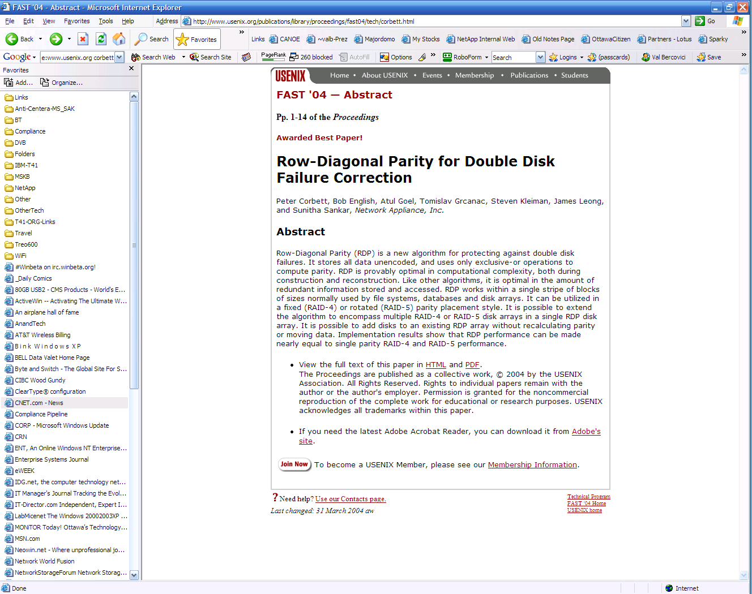
Diagonal Dual Parity RAID 6
高效能
Diagonal Dual Parity RAID 6
  RAID 4延伸一顆硬碟
  Patented Low Overhead Technology
  NetApp FAS

Slide 41
NetApp RAID及防止資料錯誤的技術
業界最佳
標竿
Features |  | NetApp FAS | EMC CX, IBM DS HDS AMS, HP EVA
Advanced Block Checksum 驗證資料讀取的正確性 | 針對每顆硬碟，驗證所讀出每個硬碟區塊資料的正確性，若資料有異常，則立刻修復，保障所讀出的任何資料都與原先所儲存的相同 |  | -
Checksum Scrub 驗證磁碟陣列資料的正確性 | 定時針對每個RAID的每個硬碟進行Parity和Checksum的檢查，以提早修復有故障的硬碟區塊，隨時保持Parity與Checksum的正確性 |  | -
Background Media Scan 驗證硬碟磁區的狀態是否正常 | 不影響系統效能，可持續在背景檢查每個磁區，包括備援硬碟在內的每顆硬碟，提早剔除有故障的磁區 |  | -
Immediate Write Verification 驗證資料寫入的正確性 | 確認每次RAID Stripe的每個Block都有正確且完整的寫入硬碟 |  | -
Predictive Disk Failure 檢驗硬碟是否真的故障並自行維修 | 能在硬碟快要故障時，就預先開始在背景將資料複製到備援硬碟；當複製完成時，立刻進行宣告該硬碟為故障，完全沒有RAID重建的等待時間。若該硬碟在背景複製期間故障了，也大幅縮小所需的RAID重建時間 |  | -

Slide 42




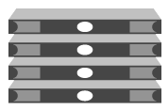
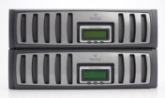

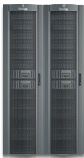

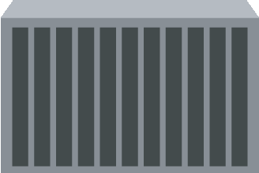




NetApp Unified Storage 應用典範
Corporate Data Center
Regional Office
Home Dirs
Exchange
Exchange
CIFS, NFS
Windows®
Servers
LAN
CIFS
NetApp
FAS Series
Home Dirs /
Network Shares
LAN
CRM
FC SAN
WAN
Regional Data Center
Linux®
Servers
NetApp
FAS Series
LAN
ERP
iSCSI
SQL Server
Exchange &
SQL Server
LAN
iSCSI
NetApp
FAS Series
UNIX®
Servers
Windows
Servers
Windows
Servers

Slide 43





NetApp提供單一架構及100%自有的儲存技術
Hi-end
SAN
Symmetrix DMX
USP/NSC
XP
(OEM HDS)
DS8000/6000
FAS Family
running
Data ONTAP®
Mid-range
SAN
CLARiiON CX/AX
AMS
EVA
DS4000
(OEM LSI)
Entry-level
SAN
Celerra
WMS
MSA
DS3000
(OEM LSI)
NAS / iSCSI
NS/NSX
(Windows/Linux)
(OEM BlueArc)
PolyServe
Software
N series
(OEM NetApp)
Compliance
Centera
Content
Archive
Platform
RISS
DR500
缺乏彈性--不同應用需要選擇不同等級的機種
缺乏技術--不同的應用需要OEM其他同業的技術
缺乏肯定--沒有真正在市場上獲得客戶的信賴

Slide 44


NetApp提供不需搬動資料擴充彈性
Switch
解決傳統IT架構無解的擴充難題
當即有容量不足時
  不需停機直接線上擴充
  NetApp提供單一檔案系統線上擴充(或縮小)可達16.8TB的容量，單一機種可達1000TB以上
當效能不足時
  數分鐘的停機時間直接升級更高效能的儲存控制器
  既有資料完全不受影響且不需任何改變
Frontend: Multiple Ethernet channel
Backend: Multiple FC-AL channel
更換主機即可直接快速升級至更高階機種
資料不受影響，不需透過其他儲存系統或磁帶系統的備份回復輔助

Slide 45





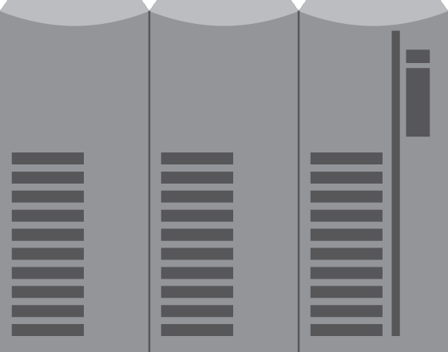

系統升級不需要資料轉換
FAS6080
NetApp FAS
FAS6040
FAS3070
1176TB
FAS3040
840TB
FAS3020
504 TB
FAS2050
336 TB
84TB
不用耗時的資料轉移即可完成升級至更高階系統
FAS2020
FAS270
99 TB
65 TB
FAS250
16 TB
4 TB
EMC: DMXDMX3, CXDMX, CXDMX3,AXCX3
IBM: DS DS
HDS: ThunderLightning, AMS USP, WMSAMS, WMSUSP
HP: EVAEVA, XPXP, EVAXP, MSAEVA, MSAXP
升級需耗時的資料轉移時間

Slide 46
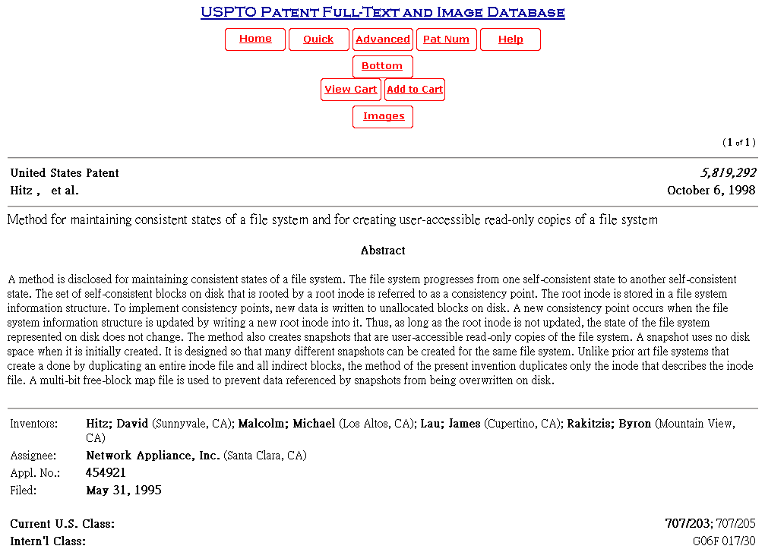
NetApp為快照技術發明者並擁有專利權
WAFL®
SnapshotTM
Source：
http://patft.uspto.gov/netacgi/nph-Parser?Sect1=PTO2&Sect2=HITOFF&p=1&u=%2Fnetahtml%2FPTO%2Fsearch-bool.html&r=1&f=G&l=50&co1=AND&d=PTXT&s1=5819292.PN.&OS=PN/5819292&RS=PN/5819292

Slide 47
NetApp SnapshotTM 的優勢
友商儲存模式
NetApp 模式
業界最佳
標竿
Snapshot
Snapshot
I/O速率
I/O速率
無造成任何性能影響
20%到60% 性能受到影響
時間
時間
Copy On Write Snapshot
Redirect On Write Snapshot
快照備份時效能嚴重受到影響
無法進行密集頻繁地備份工作
(一般而言，ㄧ天只能進行1次)
資料越大還原時間越長
快照備份時效能不受影響
可密集頻繁地進行備份工作
快速還原能力，還原時間與資料量無關
每個空間(volume)可以有255個快照備份
EMC：CLARiiON /SnapView, Celerra /SnapSure, DMX/Snap
IBM：DS/FlashCopy
HP：EVA/Vsnap, XP/Business Copy, MSA/Virtual Replicator
HDS：Copy-on-first write Snapshot
Notes:
Clearly, data centers need to be highly available. However, this often comes at a cost.
Storage industry model: every snapshot results in a 20-60% performance degradation. Because of this performance penalty, users take fewer snapshots which results in increased recover time and hence lower SLA’s.
NetApp model: Snapshot copies do not impact performance. Hence users take snapshot copies more often, resulting in higher SLA’s

Slide 48


Real World - Snapshot Performance
真正堪用的Snapshot功能
CX3-80 Performance with Snapshots goes to 50%
Source：VeriTest, Nov 2006
http://www.lionbridge.com/competitive_analysis/reports/netapp/NetApp_FAS3070_vs_EMC_CX3-80_Performance_and_Usability.pdf

Slide 49
















NetApp 1PB+ (1000TB) Customer List
65PB
1.2PB
9.5PB
1.1PB
9PB
1.1PB
4PB
1.1PB
NSA
4PB
1.1PB
1.7PB
1.1PB
1.5PB
1.1PB
1.3PB
1.2PB
1PB

Slide 50

Yahoo!全球100%採用
Yahoo全球數百個據點完全採用NetApp的Storage
僅台灣Yahoo就>>7500TB
由麟瑞科技維護建置

Slide 51


Yahoo!全球100%採用NetApp (80+ PB)
Yahoo! 全球100%採用NetApp的Storage
僅台灣雅虎奇摩就超過 8000TB
照片來源：http://tw.myblog.yahoo.com/auction-yahoo/article?mid=2958&next=2780&l=f&fid=12

Slide 52




Oracle Austin Data Center(ADC)
美國德州Austin Data Center Stats
<資料中心佔地 2 英畝>
Servers
  全球最大 Linux 伺服器的資料中心
  伺服器規模已超過 20,000 台
  伺服器擴展速度每週增加 100 台以上
Storage
  全球最大以NetApp為儲存中心的資料中心
  資料儲存量在NetApp storage已超過 9,000TB
  資料擴展速度每月增加 300TB以上
  Applications
    超過 500 mission-critical 客戶應用程式商業運轉
    Oracle 50,000名以上員工使用的主要資料中心
Oracle Running on the Grid
Source：Oracle Magazine Mar/Apr 2005 and Oracle ADC Executives

Slide 53
Redhat 採用NetApp Storage
建構了可靠而快速的軟體研發平台

Slide 54






PChome線上購物儲存備援系統
Database Clients
AP Clients
Application Server
Oracle9iRAC
DB Server
Clustering
Oracle9iRAC
DB Server 2
ERP DB
Server
NFS
LAN/WAN
每日雙向互相同步資料
NetApp
Filer
NetApp
Filer

Slide 55



台大現況示意與未來規劃
Primary Site
DR Site
Clients Access
Clients Access
WAN
WAN
Mail系統
HPCService
Windows AP/DB
NFS
NFS
ISCSI/FCP
SAN
Gigabit Ethernet
Gigabit Ethernet /
FC Switch
SAN
iSCSI/NFS
FCP/WAN/LAN
Unified Storage
Unified Storage
SnapMirror
NetApp FAS 3000 FC 16TB
NetApp FC+SATA
目前應用方式 : NAS , iSCSI
目前應用AP : Mail , HPC , AP測試開發

Slide 56
交大現況示意與未來規劃
Primary Site
DR Site
Clients Access
Clients Access
WAN
WAN
Mail系統
HPCService
Windows AP/DB
NFS
NFS
ISCSI/FCP
SAN
Gigabit Ethernet
Gigabit Ethernet /
FC Switch
SAN
iSCSI/NFS
FCP/WAN/LAN
Unified Storage
Unified Storage
SnapMirror
NetApp FAS 3000 FC 44TB
NetApp FC+SATA
目前應用方式 : NAS , iSCSI
目前應用AP :
  四種不同Mail系統 , NetFlow Data,iSCSI AP , Unix System Data

Slide 57

成大現況示意與未來規劃
Primary Site
DR Site
Clients Access
Clients Access
WAN
WAN
Mail系統
FTP Service
校務AP/DB
NFS
NFS
ISCSI/FCP
SAN
Gigabit Ethernet
Gigabit Ethernet /
FC Switch
SAN
iSCSI/NFS
FCP/WAN/LAN
Unified Storage
Unified Storage
SnapMirror
NetApp FAS 3100 FC + SATA
18TB → 46TB
NetApp FC+SATA
FC/SCSI
Backup
Backup Server
既有的Disk
Tape Library

